Slide 1
Hunt the Trojans
by Jonathan Ong, Ran Gross, and Quanjie Geng

Slide 2
Summary
An interactive cat and mouse Android app
Equipments
Server (Parse)
Android devices
Communication Methods
Wi-Fi, Cellular Data, Bluetooth

Slide 3
Game Logic
A player can either create a new game or join an existing game.
The player created the game is the cat and the players who joined the game are the mice
Cat and mice can request for the locations of everyone that is near them within a certain range
Locations are served once per 60 seconds for minute ping which both cat and mice have.
cat has a super ping that allows a request for locations once every 30 seconds.
A mouse is captured by the cat if Bluetooth connection between their devices is established.
If the cat captures all the mice within the time limit, the cat wins. Otherwise the mice win.

Slide 4
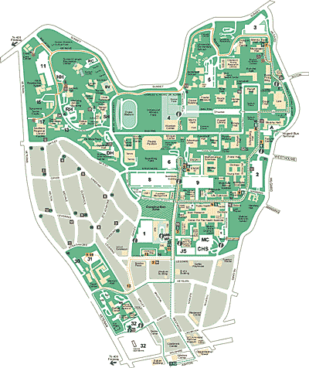




Tracking Locations
Locations
Locations

Slide 5
Bluetooth Capture
Bluetooth

Slide 6
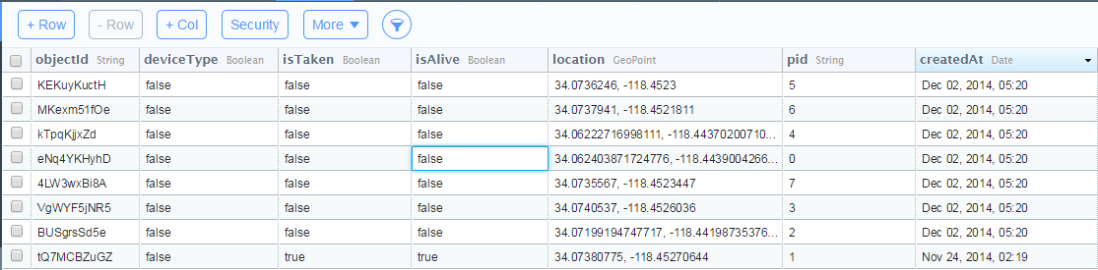
Parse
The server chosen to store data for the game.
Data stored includes:
ID of each device
whether a device ID is taken or not
whether the player is dead or alive
The locations of each device
Uses a set of queries to get data that was previously stored on the server to use for the map.

Slide 7
Google Map
A high level API that let us create a map
Move camera across the map
Zoom in or out
Draw markers
Display the device location

Slide 8
Bluetooth
Bluetooth is used for a cat to capture a mouse. The cat is the master of the piconet, and all mice are slaves of the piconet.
This Bluetooth capture is achieved through AsyncTask.

Slide 9
AsyncTask
AsyncTask will run in the background. It will constantly execute the thread’s run() function.
There are 3 asynchronous tasks in our code.
One for the Cat to make a connection for any connecting mouse.
Two for the mice: one to search for new devices and one to search through already paired devices

Slide 10
AsyncTask(cont.)
Bluetooth running in the background
Main thread

Slide 11
Ran’s Contribution
wrote the code that lets the app access the parse server.
organized the server inputs and defined the entries for the table
worked on the code for part of the game logic, different activity displays, layout of the app, and integrating the server code into the rest of the app.
For the map:
upload and download of location data that is currently allowed to be viewed
For the game logic:
upload and check conditions on the server to see if we can:
make a game
join a game
won/lost a game

Slide 12
Nero’s Contribution
Used the Google Map API to create a map in the app and support the following functionalities
Acquire the device’s current location through Wi-Fi or GPS
Update current location through a location listener
Draw a marker on the map with a location as input
Integrated Parse API for upload and download (from Ran) to support the following functionalities
Put the device’s current location on Parse as current location updates
Download the locations of other devices from Parse and draw markers for those locations upon player’s request

Slide 13
Jonathan’s Contributions
Bluetooth
Hours of research through online documentation and experimentation
Creating the BluethoothRunner and AccetThread classes wich allowed the Cat to run its Bluetooth without blocking the main thread.
Creating the ClientRunner and ConnectThread classes, which allowed the Mouse to run its Bluetooth tasks without blocking the main thread.
Creating the BackRunner and BackThread, which allowed any device to check its “already paired devices” for a reconnection.
Using the classes, programmed the socket communication between AcceptThread and ConnectThread to exchange a mouse’s ID number to the cat for further processing.
Debugging our Bluetooth implementation

Slide 14
Jonathan’s Contributions
Parse
Deciding on using Parse after considering and researching many other choices
Supporting Ran on learning how to use Parse to update server
Using Parse queries and Parse puts for game logic and Bluetooth functionality, and game logic
Google Map
Supporting Nero on Google Map API functions and with debugging
Layout
Create the GameStart activity. Created and mapped each button to functions.
Creating the HunttheTrojan activity. Configured each object so any events won't alter or distort the UI. Created and mapped each TextView and Button to the logic.

Slide 15
Jonathan’s Contributions
Game Logic
Creating “Join Game” function in the “GameStart” activity. The function makes a ParseQuery and checks the cat’s “isTaken” and “isAlive” fields. Programmed Toasts to prompt the user on the state of the game.
Creating “Make a game” function in the “GameStart” activity. The function makes a ParseQuery to check the cat’s “isTaken” field. Programmed Toasts to prompt the user depending on the response from Parse. Programmed on success to display new buttons “Drop the Cat” and “Start the Game.”
Creating “Drop the cat” function in the “GameStart” activity. The function makes a Parse submission to free the cat and resets the activity to default state. This button and the “Start the game” button are hidden.

Slide 16
Jonathan’s Contributions
Game Logic
Creating “Start the Game” function in the “GameStart” activity. The function makes a Parse submission and sets the cat’s “isAlive” to true so that mice cannot join the game once the game has started. Success will start the “HunttheTrojan” activity.
Creating the functionality for MouseConnect in the “HunttheTrojan” activity. After a connection to the cat is made, a text displays that the Mouse has lost and prompts for any action on the screen. Any action will leaves the “HunttheTrojan” activity and returns to the “GameStart” activity.
Creating the function CatConnect in the “HunttheTrojan” activity. Programmed so that after a mouse connects to the cat, the cat sets the ”isAlive” for the corresponding mouse to “false.”
Creating the Timer clock in the “HunttheTrojan” activity. Programmed this clock to update a TextView and triggers a gameEnd when the Timer has timed out.

Slide 17
Jonathan’s Contributions
Game Logic
Creating the MinutePing function in the “HunttheTrojan” activity. Programmed a Timer to act as a cool down. The button cannot be clicked until the timer has finished.
Creating SuperPing function in the “HunttheTrojan” activity. Disabled for mice; has same “cooldown” functionality as MinutePing, but runs at a much shorter duration.

Slide 18
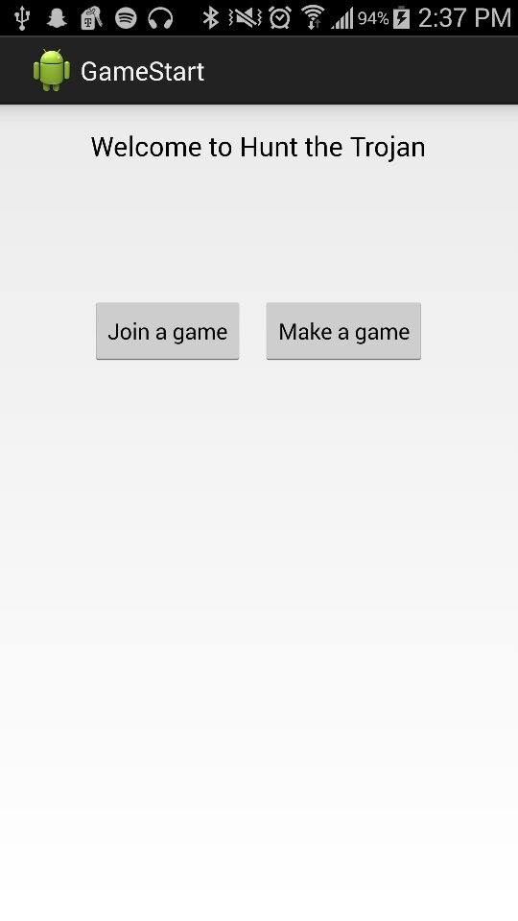
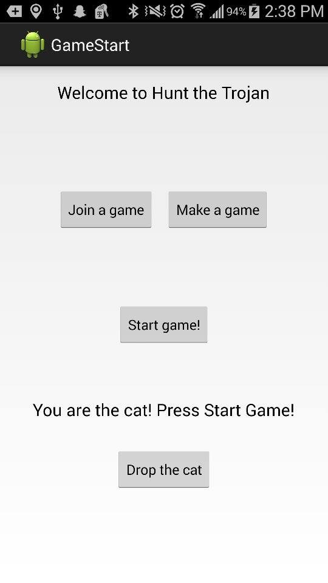
Screenshots - Start

Slide 19
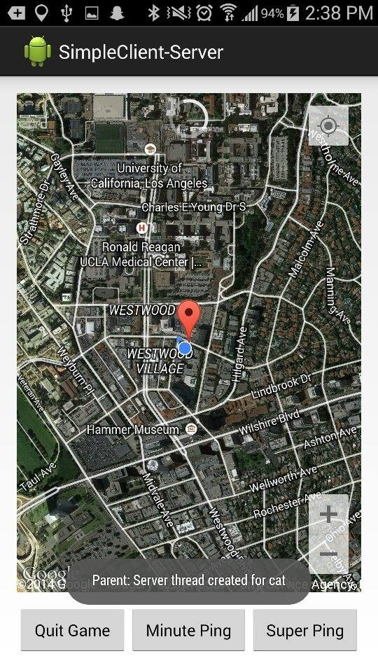
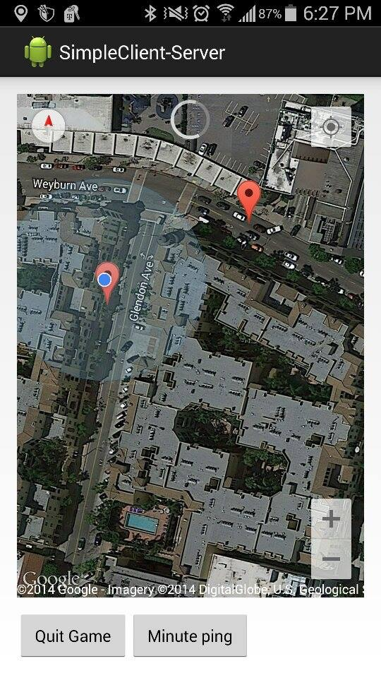
Screenshots - Map

Slide 20
Q&A
Thank you!

